Slide 1
INTERNAL ASSESSMENT- 1 COURSE-1 - EXCEL
HRITHIK S
EMP ID: 4364

Slide 2
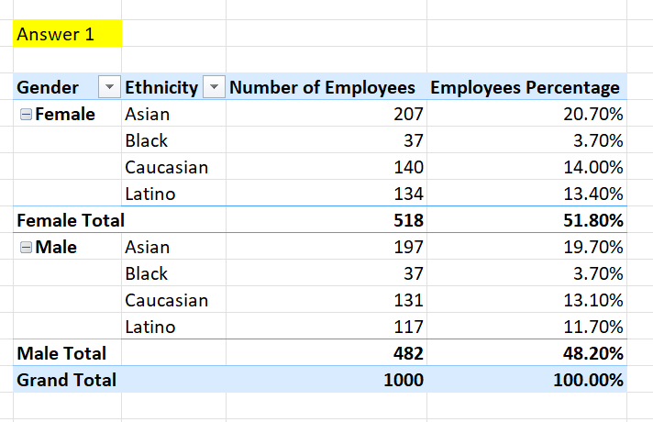
QUESTION 1: SUMMARY OF GENDER AND ETHNICITY DISTRIBUTION WITHIN COMPANY
To summarize the distribution based on the given condition,
Dividing the count employees into male and gender, then catogorize them based on their ethnicity and finding the count of individual division and finding the percentage from the total.

Slide 3
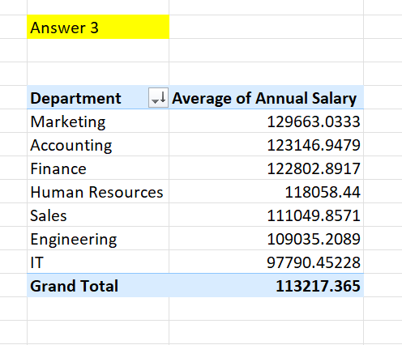
QUESTION 3: AVERAGE SALARIES BETWEEN DIFFERENT DEPARTMENTS
There is a significant difference between each departments.
Finding the average of their annual salaries by categorizing them based on the departments.

Slide 4
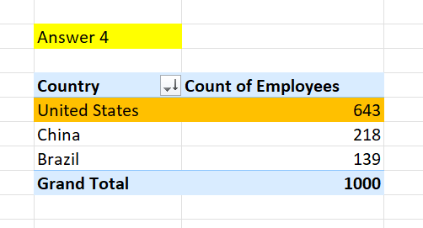
QUESTION 4: COUNTRY WITH HIGHEST NUMBER OF EMPLOYEES
By using the data, after separating the number of employees based on country, I found that United States has the highest number of employees.

Slide 5
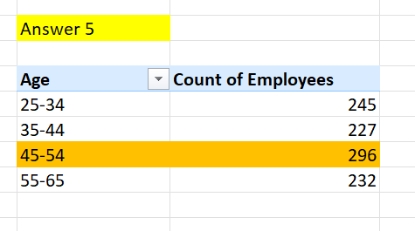
QUESTION 5: RANGE OF AGE DIFFERENCE BETWEEN EMPLOYEES
By using the data, the employee range starting from 25 to 65. After grouping range between 10 years, we found that 45 – 54 has the most number of employees.

Slide 6
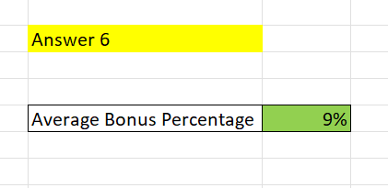
QUESTION 6: AVERAGE BONUS PERCENTAGE GIVEN TO EMPLOYEES
By using average function, I found the average percentage of bonus given to the employees from the date.
Average = 9%

Slide 7
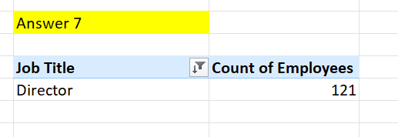
QUESTION 7: JOB TITLE WITH MOST FREQUENCY
I found that the Job Title : Director occurs most frequently in the data set.

Slide 8
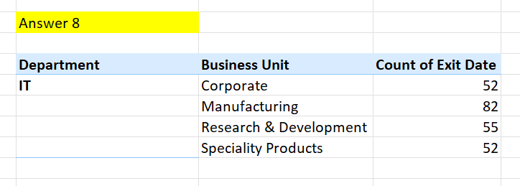
QUESTION 8: PRIMARY REASON CITED FOR EMPLOYEE EXIT
From the observation we found that IT department employees exits most the time, so we can see IT employees trying to shifts their jobs frequently.

Slide 9
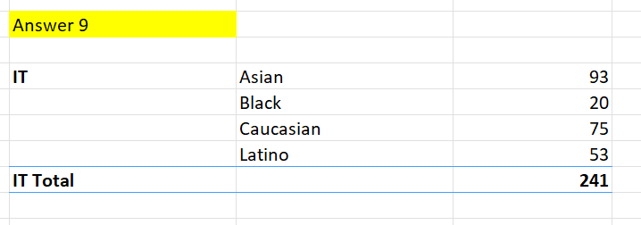
QUESTION 9: DEPARTMENT WITH DIVERSITY
From the observation we found that IT department has more diversity with number of employees with different ethnicity.

